Slide 1
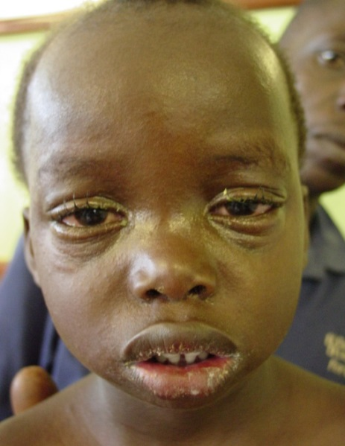
Measles disease

Slide 2
Measles disease
An acute disease
Caused by measles virus
Highly infectious: everyone exposed gets the disease if not immune
Transmission
Contact with respiratory secretions or aerosols

Slide 3
Measles disease
Classic manifestations
Fever
Maculopapular rash
The 3C: Cough, Coryza (runny nose), Conjunctivitis (red eyes)
Mortality rate
0.1 – 10%

Slide 4
Clinical course of measles
Incubation period: 14 days (range, 7 – 18 days)
Prodrome: begins 10 – 14 days after exposure
High fever, cough, coryza, conjunctivitis
Period of greatest infectiousness (virus shedding)
Rash begins: 2 – 4 days after prodrome starts
Complications: occur mostly in 2nd and 3rd weeks
Any disease or death not clearly due to another cause (e.g., trauma) during the 30 days following rash onset

Slide 5
Clinical course of measles
incubation period
( 7–18 days before rash)
prodrome
(about 4 days)
rash
(about 4–8 days)
-18
-17
-16
-15
-14
-13
-12
-11
-10
-9
-8
-7
-6
-5
-4
-3
-2
-1
0
1
2
3
4
5
6
7
8
rash
4 days after rash
18 days before rash
4 days before rash
Is the probable end of infectiousness
Exposure happened the earliest 18 days before rash
Is the probable start of infectiousness
The case is identified here

Slide 6
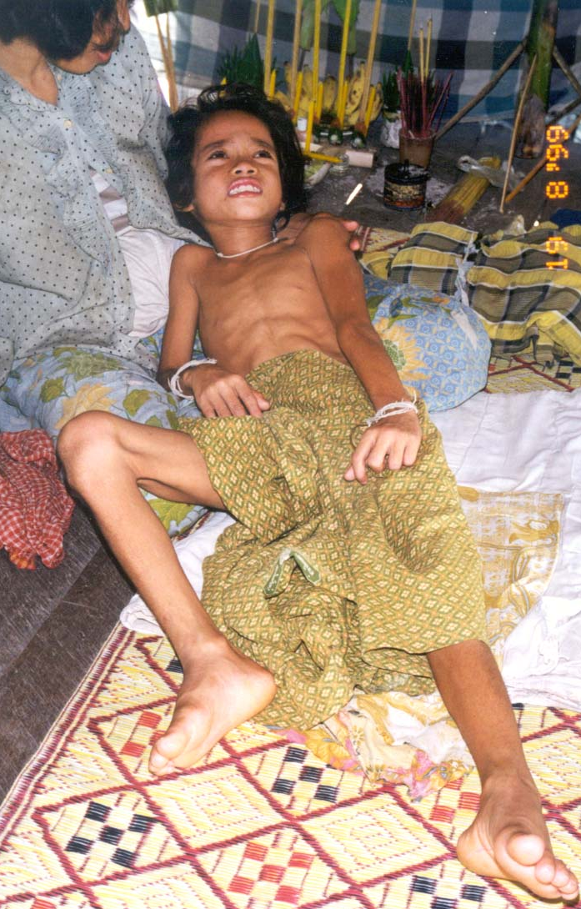
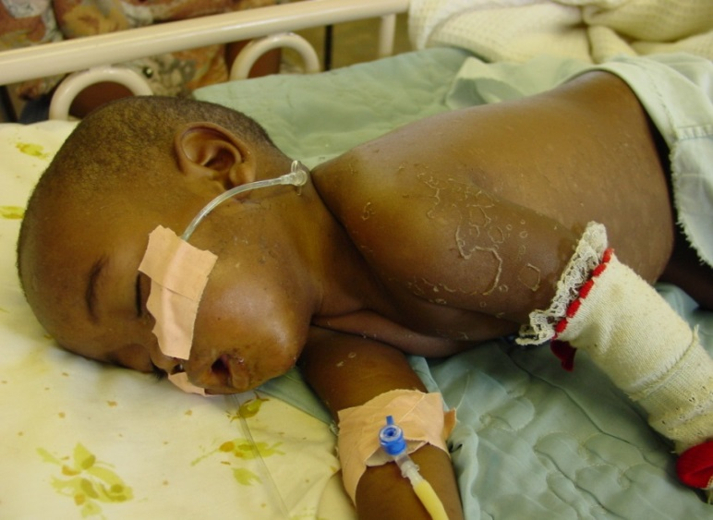
Severe measles complications
Corneal scarring causing blindness
Vitamin A deficiency
Encephalitis
Older children, adults
≈ 0.1% of cases
Chronic disability
Pneumonia &
diarrhea
Diarrhea common in developing countries
Pneumonia ~ 5-10% of cases, usually bacterial, major cause of death
desquamation
Notes:
Corneal scarring
Associated with vitamin A defiency
Historically the most common cause of blindness in children in Africa, India
Encephalitis
Older child more typically
High mortality rate
Survivors high rate of disability as here
Pneumonia & diarrhea
Pneumonia usually bacterial
Most common cause of post-measles death
Note also the skin peeling, a characteristic sign of a healing measles rash

Slide 7
Clinical course of measles and antibody dynamics
IgM appear first and disappear within 30 days. Marks the acute infection
IgG appear later and remain high for years. Mark immunity
IgG
Rash
IgM
- 14
-7
0
7
14
21
28
35
Years after illness
Prodrome
Rash
Complications zone
Days after onset
INFECTION
RASH ONSET

Slide 8
Prevention: Measles vaccine
Live attenuated virus vaccine
Excellent safety records
Among most effective public health interventions
Lifelong immunity
Efficacy:
Age (Months) | Seroconversion* (%)
6 | 50
9 | 85 (Routine EPI dose)
12 | 90
15 | 95 (SIA dose)
Seroconversion is the proportion of people who develop protective antibodies against measles virus after being vaccinated.

Slide 9
Key points measles basics
Highly infectious
Infants and adults at high risk of complications
Most complications in 2nd and 3rd weeks after rash
Effective vaccine
85% seroconversion at 9 months
>90% after 12 months

Slide 10
BATANGAS EPI ACCOMPLISHMENT
MUNICIPALITY/CITY | MEASLES (%) 2012 2013 |  | FIC (%) 2012 2013 |  | MMR (%) 2012 2013 |  | MEASLES CASES 2012 2013
AGONCILLO | 66 | 48 | 66 | 54 | 27 | o | 0 | 1
CALACA | 108 | 50 | 89 | 51 | 20 | 9 | 0 | 1
LEMERY | 83 | 47 | 77 | 61 | 39 | 20 | 1 | 0
LIAN | 100 | 51 | 100 | 56 | 85 | 19 | 0 | 0
LOBO | 87 | 35 | 78 | 74 | 82 | 70 | 0 | 0
MATAAS NA KAHOY | 78 | 45 | 78 | 53 | 31 | 0 | 0 | 0
NASUGBU | 81 | 51 | 81 | 55 | 8 | 0 | 0 | 1
PADRE GARCIA | 74 | 61 | 82 | 74 | 34 | 0 | 0 | 1
SAN LUIS | 94 | 53 | 99 | 53 | 59 | 15 | 0 | 0
TALISAY | 48 | 29 | 30 | 24 | 65 | 0 | 0 | 0
TANAUAN | 94 | 37 | 81 | 41 | 0 | 32 | 1 | 5

Slide 11
CAVITE EPI ACCOMPLISHMENT
MUNICIPALITY/CITY | MEASLES VAC 2012 2013 |  | FIC (%) 2012 2013 |  | MMR VAC (%) 2012 2013 |  | MEASLES CASES 2012 2013
GEN. TRIAS | 54 |  | 42 |  | 49 |  | 1 | 0
NAIC | 66 |  | 36 |  | 0 |  | 0 | 0
MENDEZ | 0 |  | 0 |  | 49 |  | 0 | 0
SILANG | 59 |  | 51 |  | 43 |  | 5 | 1
TAGAYTAY | 59 |  | 58 |  | 41 |  | 1 | 5

Slide 12
LAGUNA EPI ACCOMPLISHMENT
MUN/CITY | MEASLES VAC (%) 2012 2013 |  | FIC (%) 2012 2013 |  | MMR VAC (%) 2012 2013 |  | MEASLES CASES (%) 2012 2013
CALAMBA | 92 | 96 | 87 | 88 | 43 | 88 | 0 | 5
CALAUAN | 78 | 47 | 48 | 31 | 8 | 25 | 0 | 1
CAVINTI | 59 | 39 | 47 | 37 | 43 | 42 | 0 | 0
LILIW | 63 | 60 | 55 | 45 | 26 | 42 | 0 | 0
LUMBAN | 78 | 66 | 59 | 58 | 37 | 31 | 0 | 0
LUISIANA | 89 | 58 | 85 | 58 | 41 | 48 | 0 | 0
MABITAC | 57 | 49 | 52 | 41 | 10 | 21 | 0 | 0
PAETE | 62 | 39 | 79 | 48 | 19 | 30 | 0 | 0
PANGIL | 76 | 53 | 60 | 49 | 30 | 24 | 0 | 0
SAN PEDRO | 36 | 35 | 25 | 25 | 25 | 22 | 2 | 2
SAN PABLO | 80 | 82 | 59 | 52 | 56 | 67 | 1 | 13
STA. MARIA | 55 | 43 | 54 | 43 | 7 | 31 | 0 | 0
SINILOAN | 87 | 64 | 68 | 46 | 39 | 24 | 0 | 0

Slide 13
QUEZON EPI ACCOMPLISHMENT
MUN/CITY | MEASLES VAC (%) 2012 2013 |  | FIC (%) 2012 2013 |  | MMR VAC (%) 2012 2013 |  | MEASLES CASES (%) 2012 2013
AGDANGAN | 49 | 59 | 18 | 30 | 16 | 26 | 0 | 0
ALABAT | 83 | 70 | 85 | 49 | 48 | 62 | 0 | 0
GUINYANGAN | 54 | 40 | 17 | 24 | 11 | 17 | 0 | 0
INFANTA | 50 | 53 | 23 | 38 | 15 | 16 | 0 | 0
LUCBAN | 51 | 75 | 42 | 59 | 4 | 36 | 0 | 0
MACALELON | 42 | 37 | 47 | 25 | 12 | 9 | 0 | 0
PEREZ | 76 | 64 | 74 | 75 | 30 | 71 | 0 | 0
PITOGO | 71 | 75 | 65 | 75 | 29 | 40 | 0 | 0
PLARIDEL | 73 | 62 | 63 | 53 | 41 | 29 | 0 | 0
POLILIO | 77 | 88 | 63 | 84 | 58 | 37 | 0 | 0
SAN ANTONIO | 95 | 53 | 81 | 20 | 37 | 19 | 0 | 0
TIAONG | 76 | 84 | 50 | 66 | 33 | 33 | 0 | 0

Slide 14
RIZAL EPI ACCOMPLISHMENT
MUN/CITY | MEASLES VAC (%) 2012 2013 |  | FIC (%) 2012 2013 |  | MMR VAC (%) 2012 2013 |  | MEASLES CASES (%) 2012 2013
Baras | 82 | 83 | 78 | 63 | 59 | 63 | 0 | 0
Cainta | 98 | 61 | 99 | 55 | 68 | 72 | 1 | 4
Jala-Jala | 114 | 67 | 115 | 65 | 57 | 46 | 0 | 0
Morong | 101 | 85 | 106 | 85 | 54 | 57 | 0 | 1
Taytay | 85 | 73 | 74 | 69 | 48 | 51 | 0 | 1
Teresa | 78 | 64 | 70 | 60 | 54 | 26 | 0 | 0
Antipolo City | 58 | 62 | 47 | 54 | 31 | 37 | 4 | 15

